Slide 1
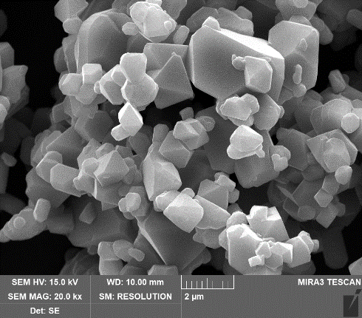
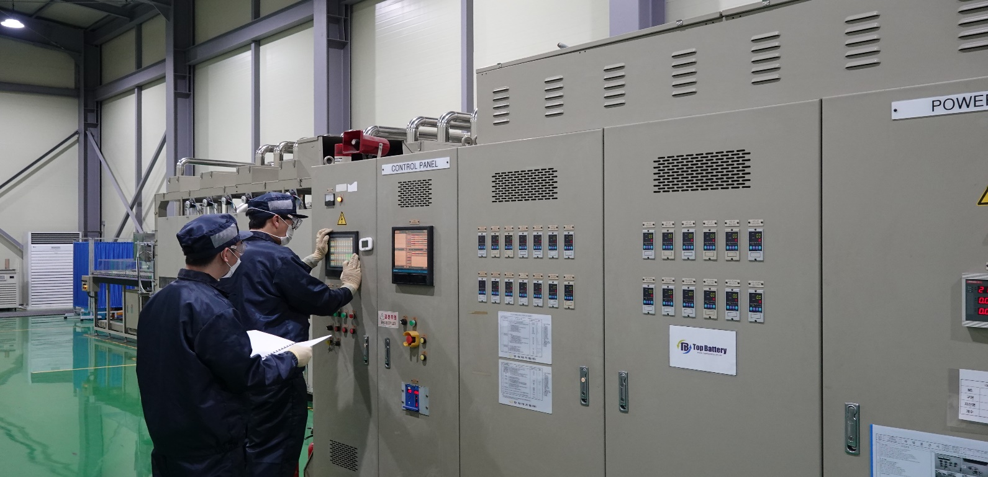
Cobalt free, Single Crystal LMNO Spinel (Model HPS55)
Next generation cathode active material; LiMn_{1.5-x}Ni_{0.5-y}M_{x+y}O₄
Superior safety
2. High specific energy with flat potential at 4.7V vs Li/Li⁺
3. Cobalt free and less Nickel (Manganese rich)
High rate capability
Compatible with aqueous binder

Slide 2
Differential scanning calorimeter(DSC) analysis
with various cathode material
Scan rate : 5℃/min
Sample | Onset temperature (℃) | Peak temperature (℃) | Enthalpy (J g⁻¹)
NCM811 | 197.8 | 208.7 | 1514
LCO | 257.2 | 261.4 | 1665
LFP | 251.1 | 275.5 | 99
LMO | 263.4 | 270.9 | 1450
LMNO | 302.4 | 338.1 | 931
<Test method>
Electrode is made with each cathode material;
Coin cell is assembled with Li counter electrode;
Each coin cell is disassembled in fully charged state;
Electrode is rinsed with dimethyl carbonate;
Each powder is collected and analyzed by DSC
Top Battery LMNO(HPS55) is single crystal structure and shows superior safety
compared with other commercial cathode material.
It decomposes at much higher temperature without significant heat flow.

Slide 3
High specific capacity at high flat potential
Cathode Material | Specific capacity (mAh/g) | Discharge potential (Volt) | Specific energy (Wh/kg)
NCM622 | 170 | 3.65 | 621
NCM811 | 190 | 3.65 | 694
LFP | 135 | 3.25 | 439
LMO | 105 | 3.85 | 404
LMNO(HPS5) | 137 | 4.70 | 644
2032 coin cell with Li counter electrode
Charge : CCCV, 0.1C, 4.9V, 0.05C cut off
Discharge : CC, 0.1C, 3.0V Cut off
The specific capacity of HPS55 is over 135mAh/g with high flat potential at 4.7V.
The specific energy is compatible with NCM622.

Slide 4
High C rate capability
2032 coin cell with loading of 0.9mAh/cm²
Charge : CCCV, 1C, 4.9V, 0.05C cut off
Discharge : CC, 0.5C, 1C, 3C, 5C, 10C, 3.0V Cut off
Single crystal HPS55 is optimal structure for Li⁺ diffusion.
Cathode composition of 2wt% conductive carbon and 2wt% PVdF binder
shows superior high rate discharge capability.

Slide 5
Good cycle life at room and high temperature
2032 coin cell with loading of 0.9mAh/cm²
Charge : CCCV, 1C, 4.9V, 0.05C cut off
Discharge : CC 1C, 3.0V Cut off
Single crystal HPS55 shows good cycle life with Li counter electrode.

Slide 6
Good cycle life at 21700 cylindrical cell of LMNO/LTO
21700 cylindrical cell with loading of 3.0mAh/cm²
Charge : CCCV, 0.3C, 3.4V, 0.05C cut off
Discharge : CC 0.5C, 2.5V Cut off
Single crystal HPS55 shows good cycle life with Li₄T₅O₁₂ anode.

Slide 7
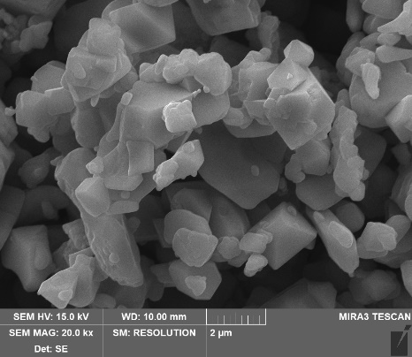
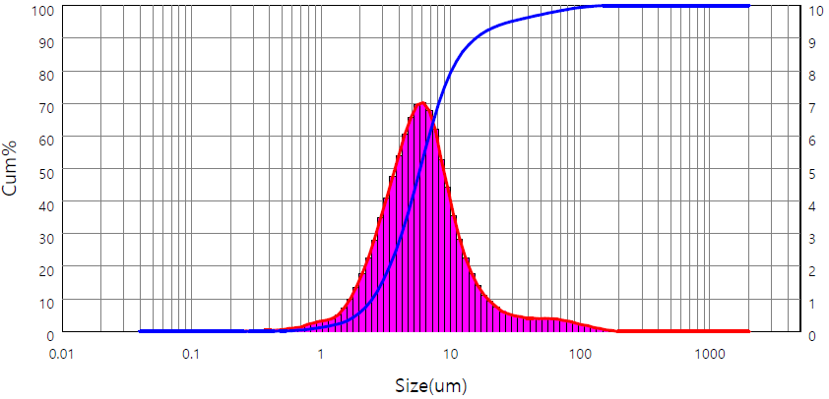
Specification and Certificate of analysis
ITEM |  | Unit | Specification | Result | Remark
Particle Size | D10 | μm | ≥1.0 | 2.481 | Laser particle size analyzer
 | D50 |  | 4.0 – 7.0 | 5.832
 | D90 |  | <20.0 | 15.63
Tap Density |  | g/cm³ | ≥1.60 | 1.62 | ISO 3953 (250tap/min, 5min)
Specific capacity @0.1C |  | mAh/g | ≥ 130mAh/g | 137.6mAh/g | 2032 Coin Cell (3.0V – 4.9V, Li CE) 0.9mAh/cm²
1st Cycle efficiency |  | % | ≥ 88% | 88.5%

